Slide 1
How to harness the torrent of sensor data … from personal to industrial Internet of Things (IoT)
Michael Hausenblas, Chief Data Engineer, EMEA
Alexander Thamm Summer Event, Munich, Germany 2014-09-18

Slide 2
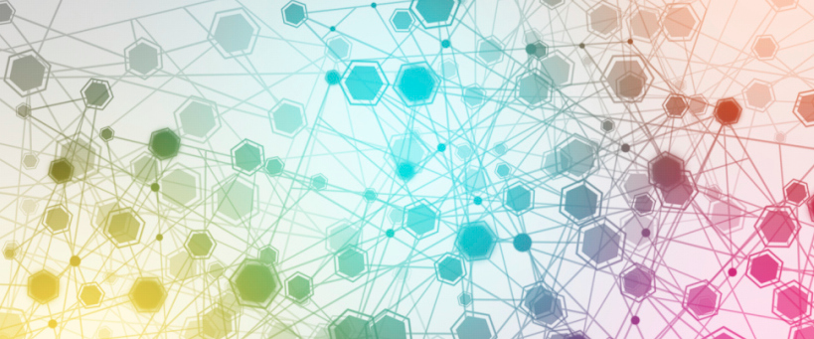
IoT—a superset of the Internet
What is the IoT?
“The idea of an all-encompassing and ubiquitous network of devices to facilitate co-ordination and communication between the devices themselves as well as between the devices and human end-users. The involved devices are typically constrained devices such as RFID sensors, but may also more sophisticated ones like smartphones.”

Slide 3
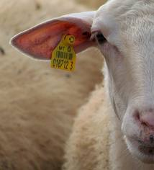
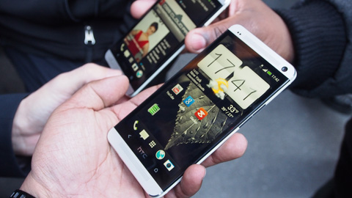

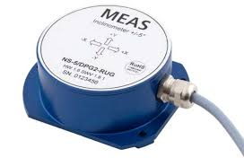
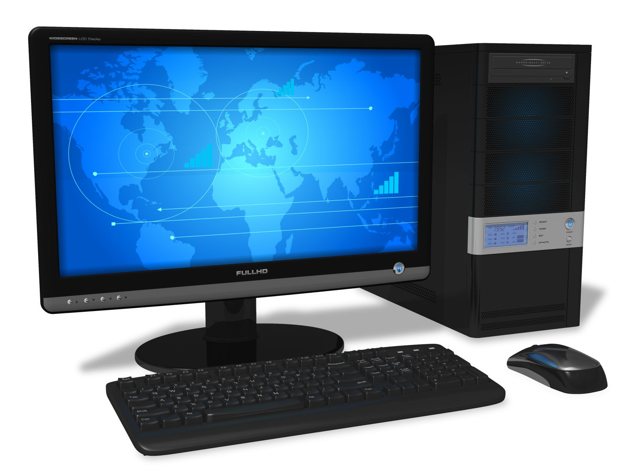
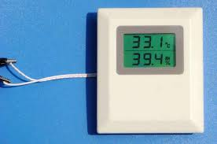
IoT—a superset of the Internet
mobile
thin
fat
stationary
devices and their deployment

Slide 4
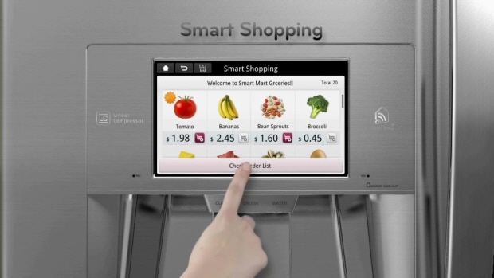
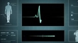

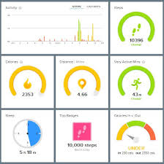




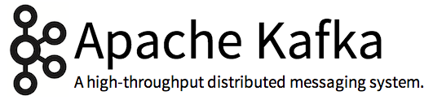
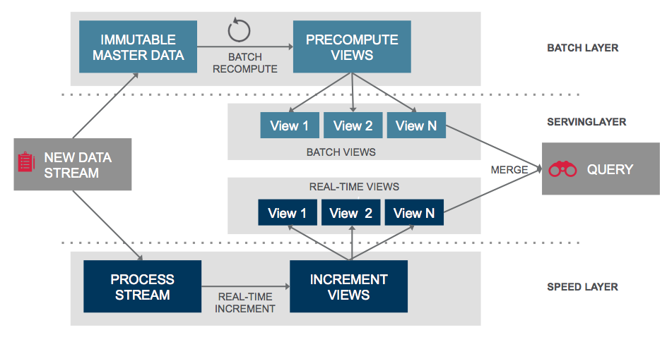





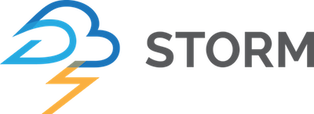
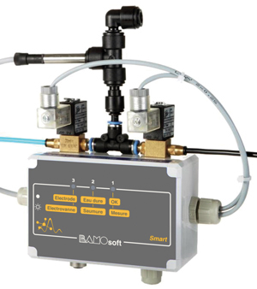
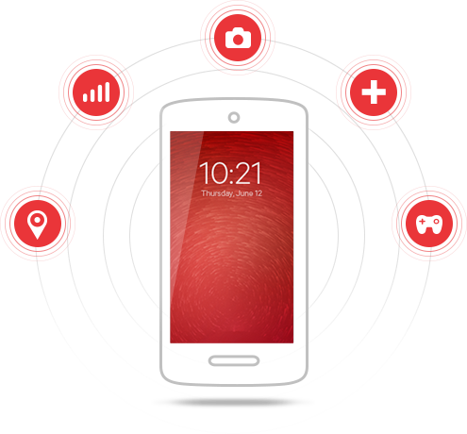
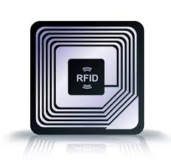


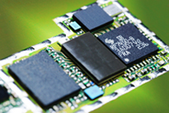

The IoT landscape
apps
data
infrastructure
Notes:
Explains the IoT landscape in terms of (commercial) players and consortia

Slide 5
IoT use case categories and apps

Slide 6
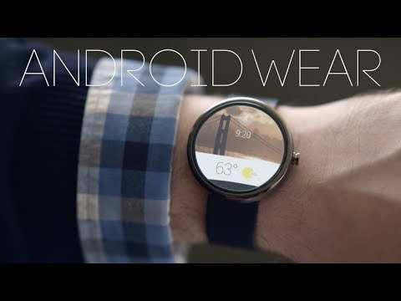

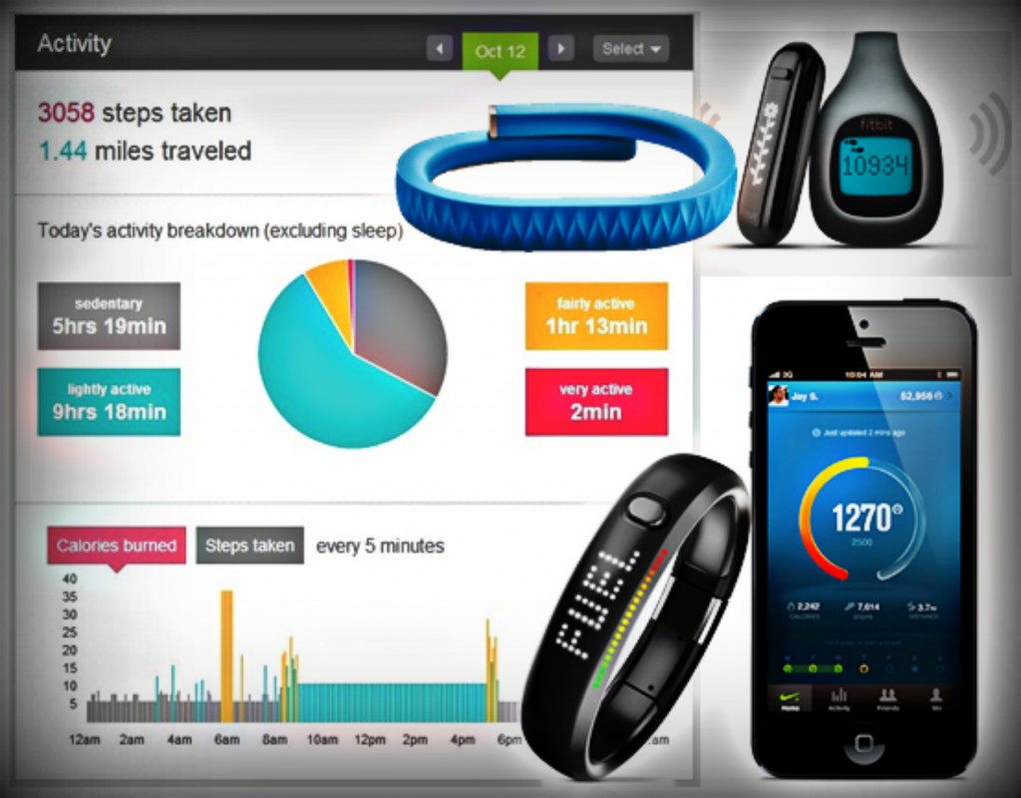
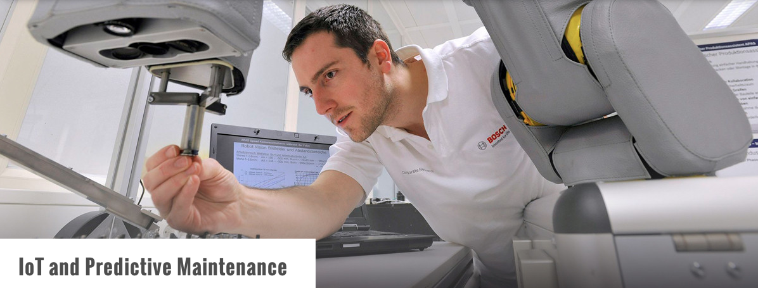
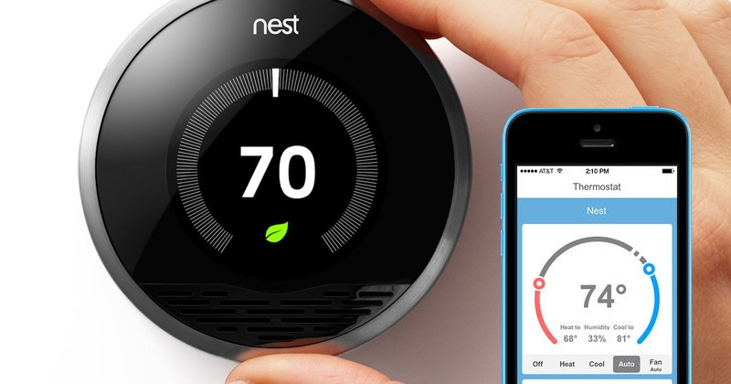
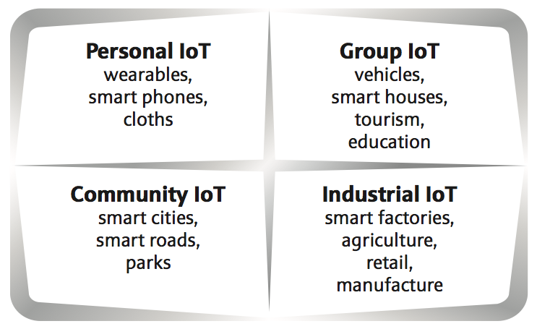
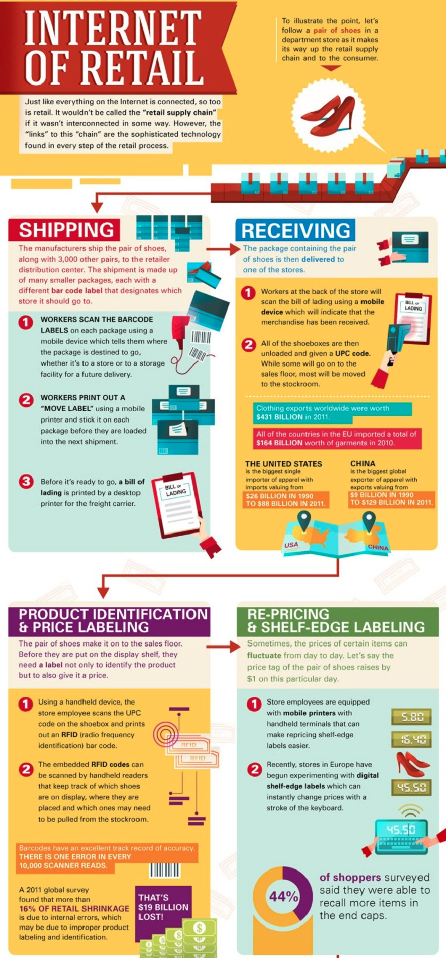
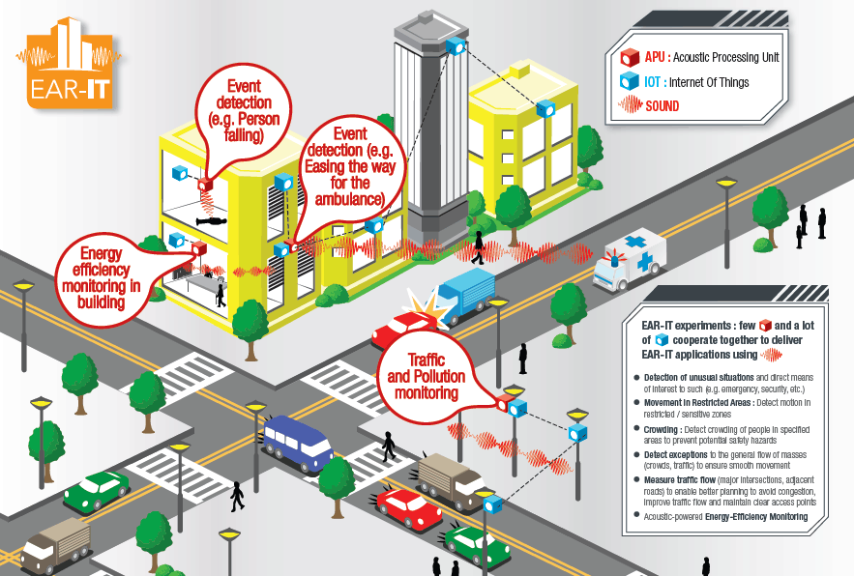
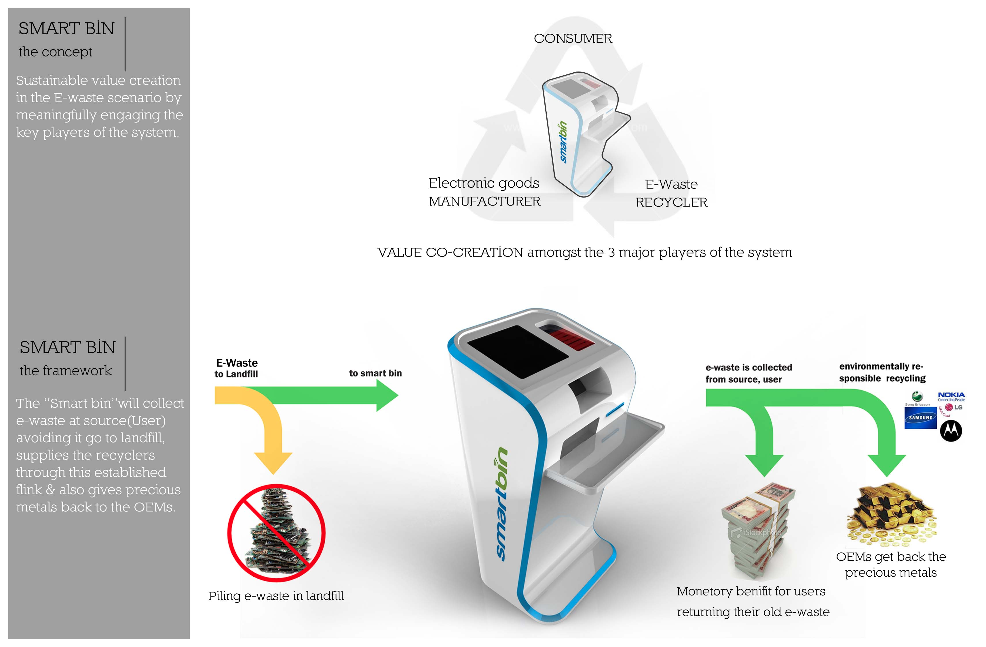
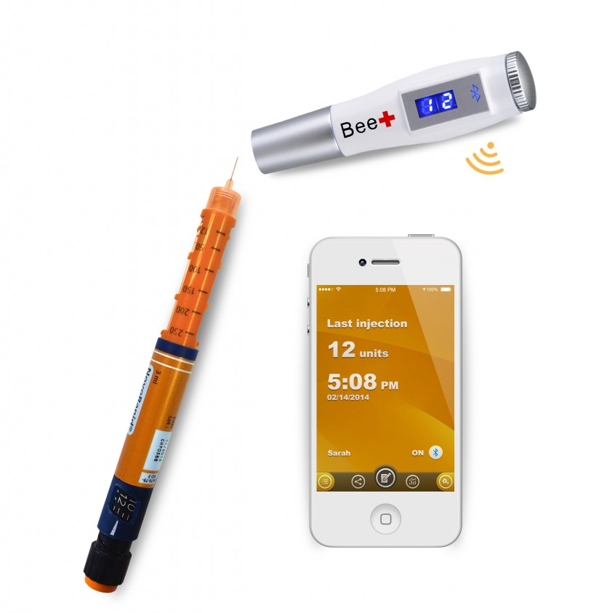
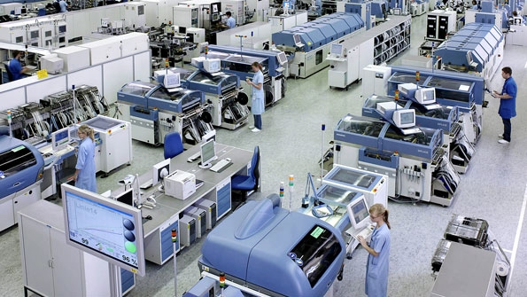
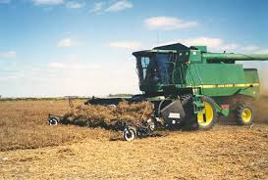
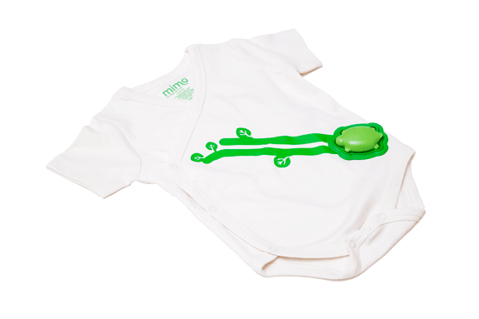
Use case categories

Slide 7
Business Intelligence and the IoT

Slide 8


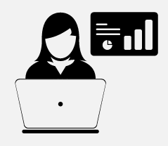

The value of BI
predictive analytics
what might happen?
real-time analytics what and why is it happening, now?
OLAP why did it happen?
reporting what happened?
business value
Notes:
The value increases the more recent, more accurate, more all-encompassing the activity is
For example, it’s good to see in a report that last week you’ve sold 100 articles from a certain category, however it’s much more insightful to have a break-down (in which region? who bought it? which other articles have been bought together with this article?)
Also, for many businesses real-time information about buyers behavior are essential (think: events, auctions, etc.)
Predicting the future is never easy, but providing good enough indicators for humans to take (or avoid) certain actions can make a huge difference to the bottom-line

Slide 9

Technologies typically used to realise …
 |  | Back-end | Front-end
 | reporting | Hive, Pig, Spark SQL (Shark) | Excel, Tableau, Datameer
 | OLAP | Hive/HBase/M7 tables + Drill/Impala/Vertica | SAS, QlikView, Tableau, Datameer
 | real-time analytics | Kafka + Storm/Spark Streaming + Hive | DataTorrent, bespoke dashboards (web applications)
 | predictive analytics | Potentially all above + Elasticsearch/Solr Mahout/Spark MLLib | Often bespoke apps
Notes:
Back-end means: the stuff that stores, processes, analyzes, queries, etc. the data
Front-end means: the user-facing stuff, some kind of app (desktop of Web) that either an internal user, such as a business analyst (BA) or an end-user (like you and me) uses. For example, SAS might be used for an BA while we use, for example Salesforce in the browser.

Slide 10

MapR’s offering
APACHE HADOOP AND OSS ECOSYSTEM
Batch
ML, Graph
SQL
NoSQL & Search
Streaming
Data Integration
& Access
Security
Provisioning
&
Coordination
Workflow
& Data Governance
Tez
Spark
Drill
Cascading
GraphX
Spark SQL
Accumulo*
Kafka
Hue
Savannah*
Pig
MLLib
Impala
Solr
Storm
HttpFS
Juju
MapR Control System
(Management and Monitoring)
MapReduce v1 & v2
Mahout
Hive
HBase
Spark Streaming
Flume
Knox*
Falcon*
Whirr
YARN
Sqoop
Sentry*
Oozie
ZooKeeper
EXECUTION ENGINES
DATA GOVERNANCE AND OPERATIONS
NFS
HDFS API
HBase API
JSON API
MapR-FS
(POSIX)
MapR-DB
(High-Performance NoSQL)
MapR Data Platform
(Random Read/Write)
Enterprise Grade
Data Hub
Operational

Slide 11
Demo: Connected Car on MapR Data Platform

Slide 12

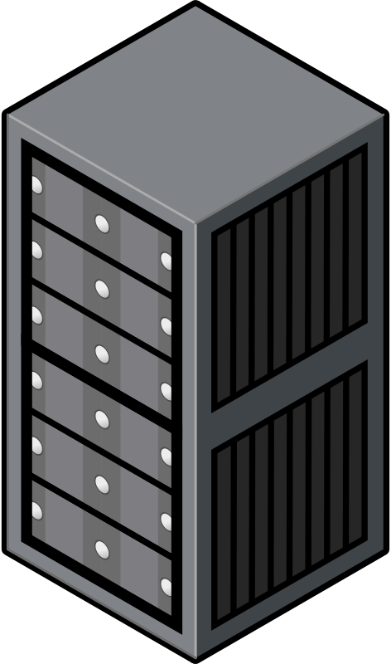

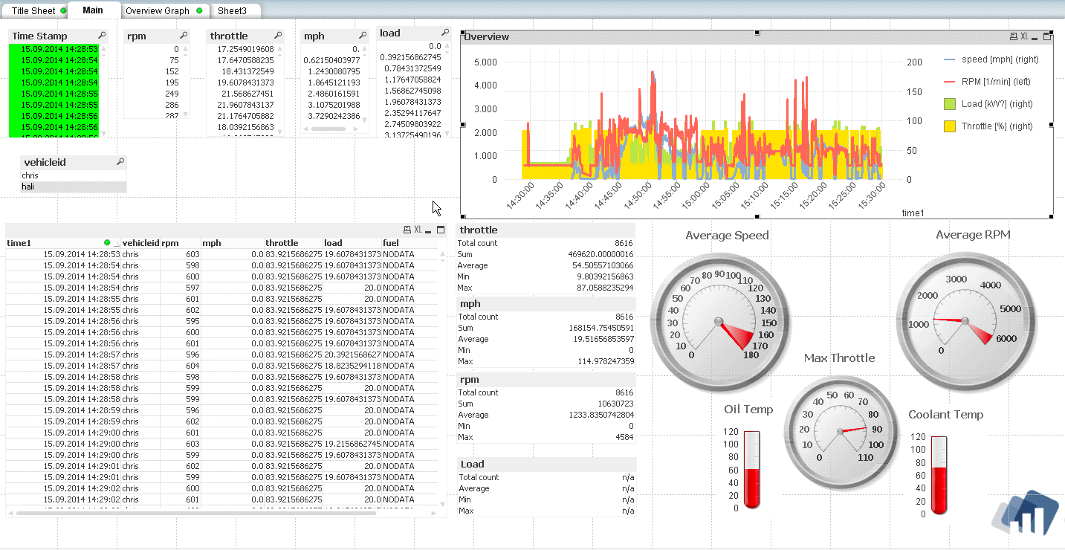


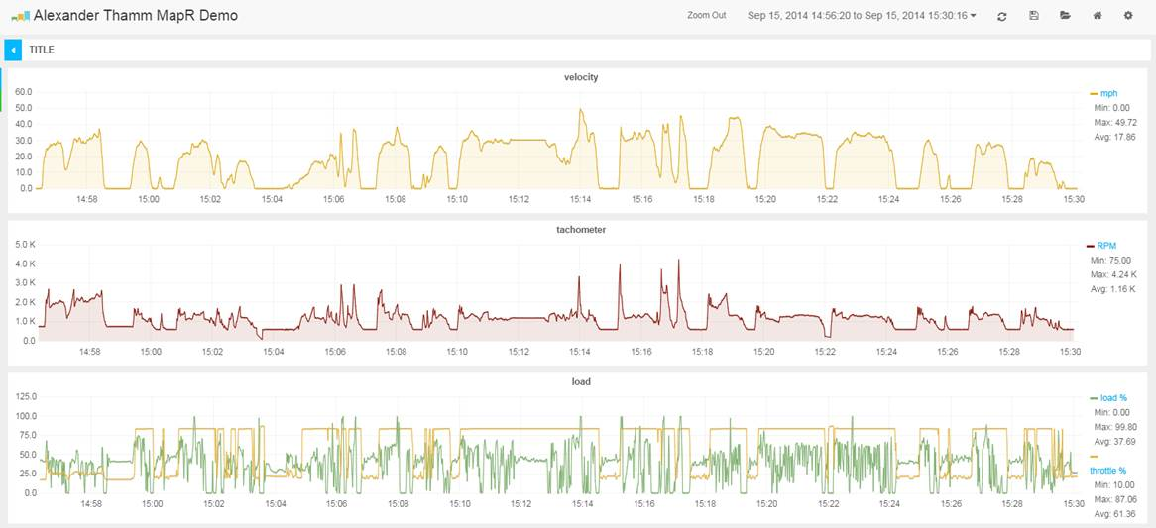

Data Acquisition
Data Store & Analytics
Data Visualization
OBD2
QlikView
Raspberry PI
Grafana
fluentd
fluentd
real-time dashboard

Slide 13
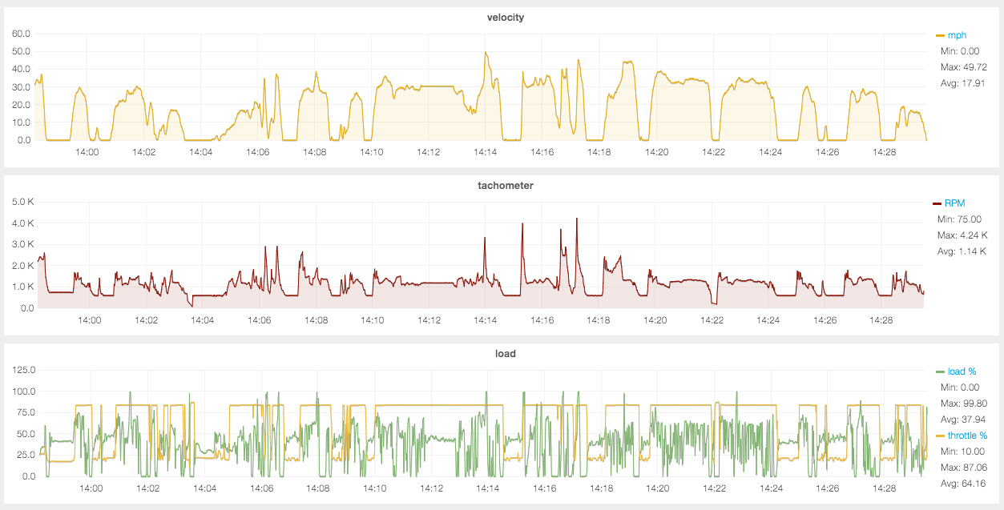
Demo time!

Slide 14
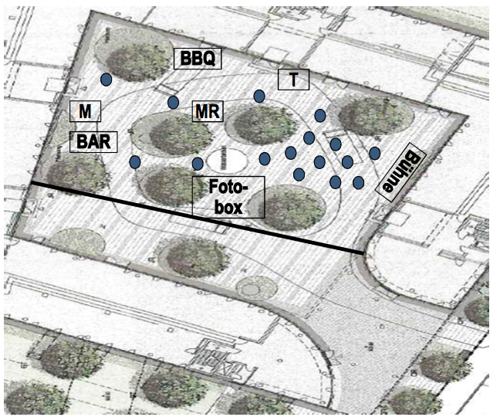
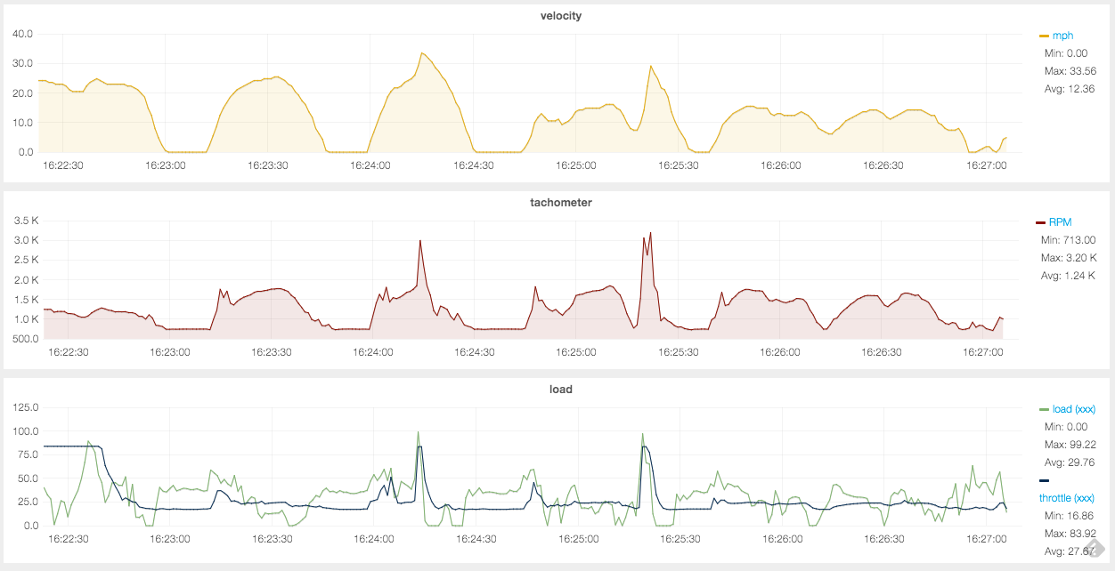
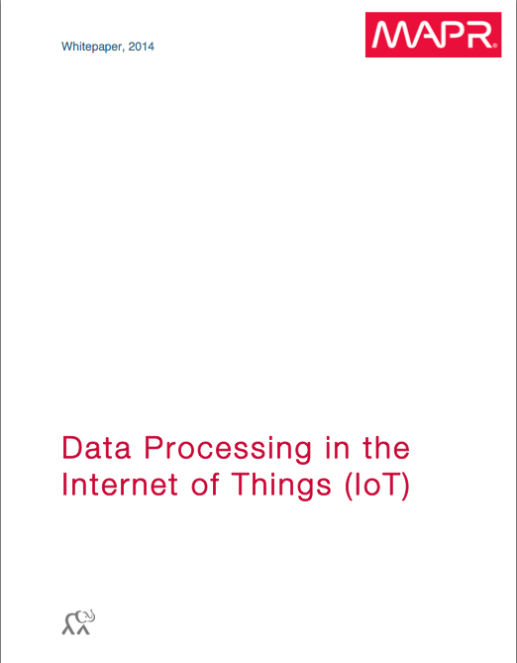
… come and visit us at our stand, experience the live demo and grab your copy of the IoT whitepaper!

